Slide 1
Automated in-situ sensors & Spatiotemporal Monitoring & Machine Learning prediction of Harmful Algal Blooms - Case Study-Lake Victoria
Presenter:
Name: OKELLO, JACOB OKOMO
Reg. No: ENC222-0149/2017

Slide 2
Introduction
Toxic Cyanobacteria-rich Harmful Algal Blooms (CyanoHABs) , a phenomenon in which the water body e.g. lakes turns dark blue-green due to excessive algal growth; potentially harming humans and animal, e.g., Unsightly nuisance, acute liver damage when ingested, irritation, fish deaths, whatnot.
Hence, quantifying the detailed spatial distributions of CyanoHABs in L. Victoria on a regular and frequent basis is of great significance, which requires high spatiotemporal resolution monitoring abilities- (Sitoki et al., 2012)
There however exists that niche to support the near-real time space observations with a geointelligent reporting system and further predict any looming bloom.

Slide 3
Problem statement
Previous studies on the same problem by
After reviewing the papers and gaps – what exactly is the problem? state this explicitly.
Ensure you mention the problem, area, and in detail the problem specifics

Slide 4
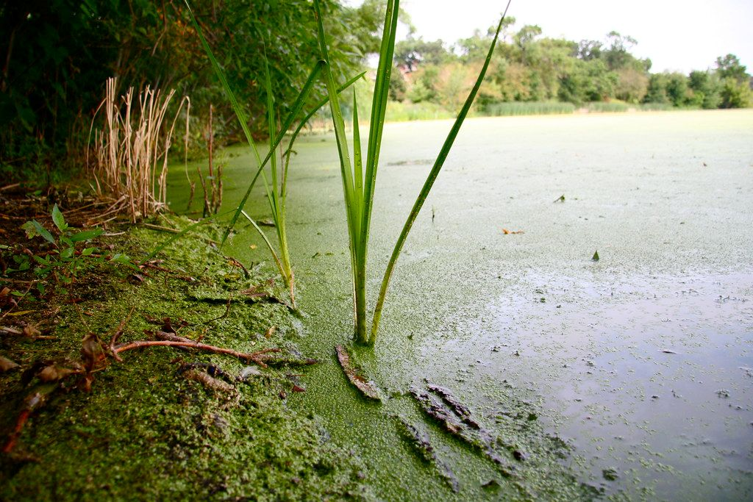
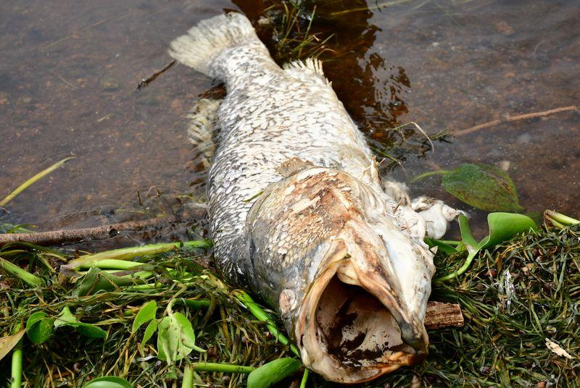
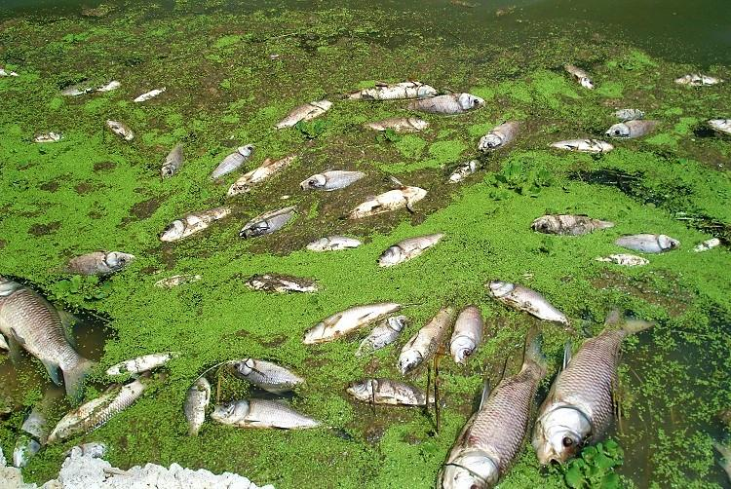
Justification

Slide 5
General and specific objectives
To monitor and predict the occurrence of Harmful Algal Blooms(HABs) and Cyanobacteria.
To develop automated in-situ Internet of Things(IoT) sensors to monitor the occurrence of the event.
To develop a system that reports specified geo-tagged data from the above sensors.
To associate Machine Learning models to predict the occurrence of CynoHAB.

Slide 6
Overall Methodology : Data and Materials
Data & Materials;
Data Type | Source | Access
Shapefiles | Database of Global Administrative Areas- GADM | Free
MODIS Aqua | Google Earth Engine Cloud Repo | Free
Landsat 8 OLI | Google Earth Engine Cloud Repo | Free
- Meteorology Data -In-Situ | -Lake Victoria Water Quality Mgt -My Automated In-situ System | -Uncertain -Within my control
Tool/ Material | Role | Availability
Google Earth Engine | Geocomputation & Processing | Freely Available
QGIS, R & Python | Further Analysis, Maps & Prediction | Free
Microcontroller, Sensors & Gateway | In-situ data collection & Monitoring | Local Purchase

Slide 7
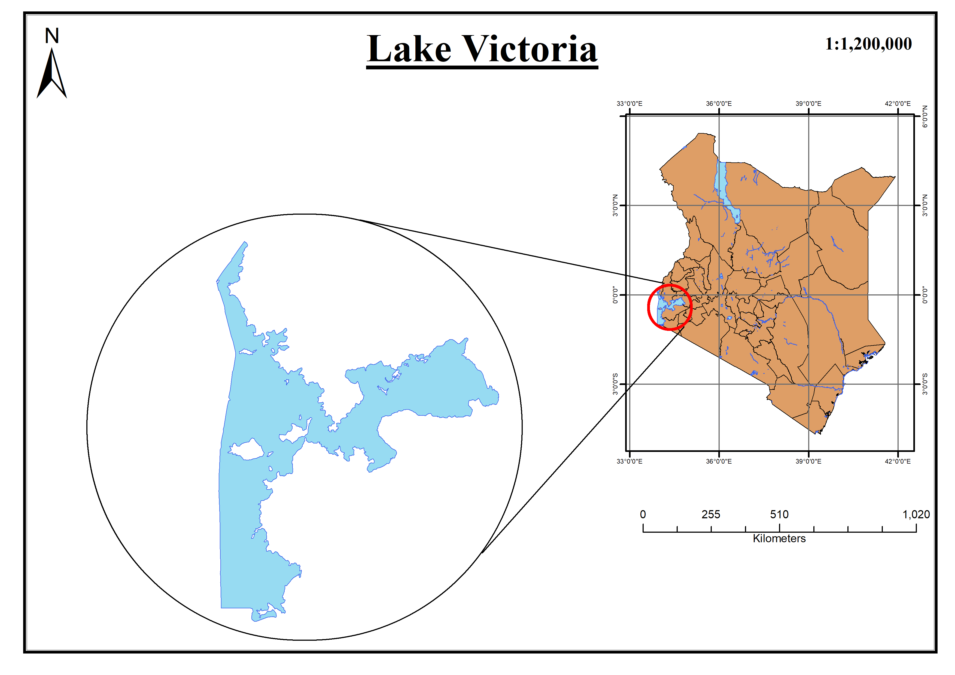
Study Area

Slide 8
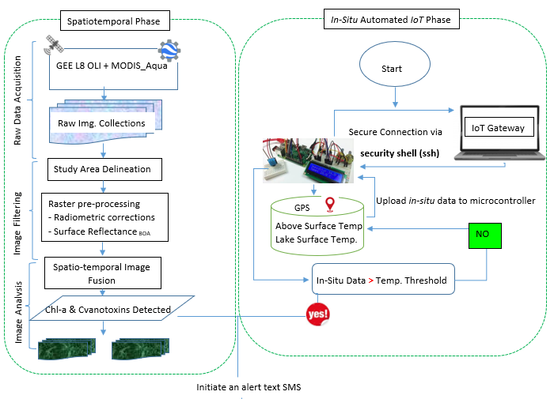
Overall methodology

Slide 9
Expected Results
Chlorophyl-a Geographical Maps associating the occurrence of the Harmful Algal Blooms and Cyanobacteria.
Automated system that monitors and reports geo-tagged data
Reported confirmation alert Text SMS reporting in near-real time the in-situ status from the sensors.
Time Series predictive model on any looming bloom.

Slide 10
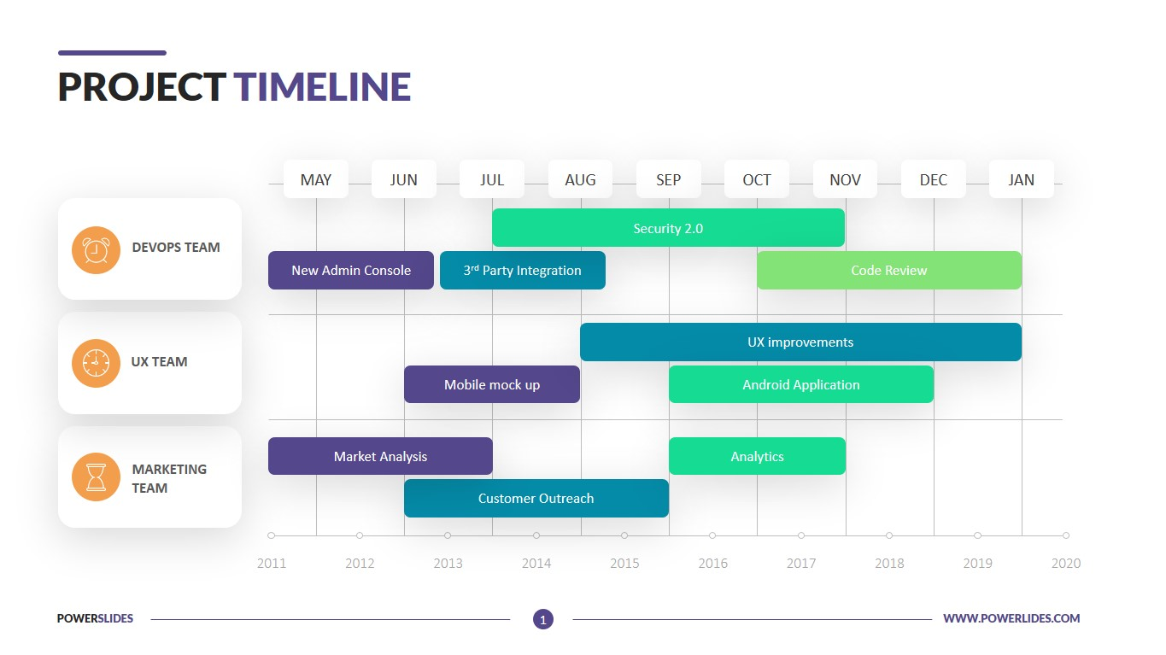
Project Timeline

Slide 11

Thank you for your attention! Questions?

